Slide 1
Basic Computer Organization and Architecture
MODULE 1

Slide 2
Digital Computers
Dr. Chhaya S Dule
Associate Professor
Dept of CSE
Sapthagiri NPS University
Bangalore

Slide 3
Syllabus
Module 1 : Digital Computers
Introduction—Block diagram of Digital Computer— Definition of Computer Organization—Computer Design and Computer Architecture.
Data Representation: Number system –Decimal, Binary, Octal & Hexadecimal, Conversion-BCD-Binary, Octal to Hexadecimal, Hexadecimal to Octal,,Complements : 1’s , 2’s, 9’s,10’s, Subtraction. —Fixed Point Representation—Floating Point representation. Computer Arithmetic: Addition ,subtraction and Multiplication with signed magnitude( Hardware implementation & algorithm), Booth Algorithm, Array Multiplier, Division
Floating point Arithmetic operations—Decimal Arithmetic unit —Decimal
Arithmetic operations.(BCD adder, subtractor)

Slide 4
Data Representations
It refers to the form in which data is stored, processed, and transmitted.
Devices such as smartphones, iPods, and computers store data in digital formats that can be handled by electronic circuitry (motherboard).
It refers to the symbols that represent people, events, things, and ideas. Data can be a name, a number, the colors in a photograph, or the notes in a musical composition.

Slide 5
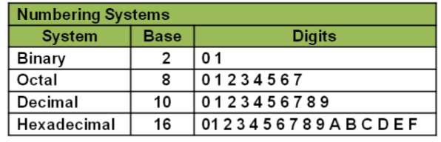
Data Representations
The term “data” refers to factual information used for analysis or reasoning.
Registers are made up of flip-flops and flip-flops are two-state devices that can store only 1’s and 0’s.

Slide 6
Data Representations
There are many methods or techniques which can be used to convert numbers from one base to another.
Decimal to Other Base System
Other Base System to Decimal
Other Base System to Non-Decimal

Slide 7
Data Representations
Shortcut method−Binary to Octal
Shortcut method−Octal to Binary
Shortcut method−Binary to Hexadecimal
Shortcut method−Hexadecimal to Binary
Decimal to Other Base System

Slide 8
Decimal to Binary Conversion
Step1 −Divide the decimal number to be converted by the value of the new base.
Step 2− Get the remainder from Step 1 as the rightmost digit (least significant digit) of new base number.
Step3−Divide the quotient of the previous divides by the new base.
Step4−Record the remainder from Step3 as the next digit (to the left ) of the new base number.
Repeat Steps 3 and 4, getting remainders from right to left, until the quotient becomes zero in Step 3.
The last remainder thus obtained will be the Most Significant Digit (MSD) of the new base number.

Slide 9
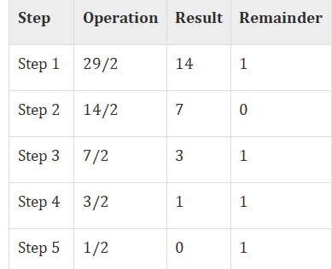

Decimal to Binary Conversion
Example: Decimal number: ${29}_{10}$
Calculating Binary Equivalent
Decimal number $:{29}_{10}$
Binary number : ${11101}_{2}$

Slide 10
Binary to Decimal Conversion
Step 1− Determine the column (positional) value of each digit (this depends on the position of the digit and the base of the number system).
Step2−Multiply the obtained column values (inStep1) by the digits in the corresponding columns.
Step3−Sum the products calculated in Step2.The total is the equivalent value in decimal.

Slide 11
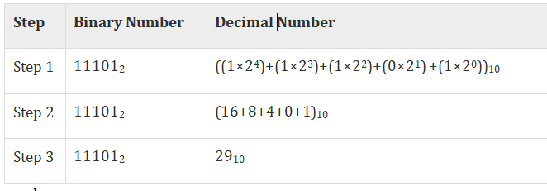
Binary to Decimal Conversion
Binary Number – 11101₂
Calculating Decimal Equivalent−
Binary Number−11101₂=Decimal Number−29 ₁₀

Slide 12
Other Base System to Non-Decimal System
Step 1: Convert the original number to a decimal number (base10).
Step 2 : Convert the decimal number obtained to the new base number.

Slide 13
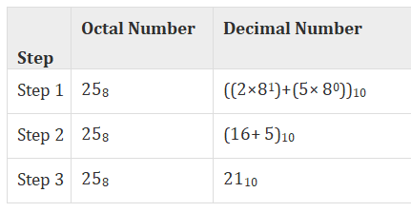
Other Base System to Non-Decimal System
Example
Octal Number−25₈
Calculating Binary Equivalent− Step 1 − Convert to Decimal
Octal Number−25₈=Decimal Number−21₁₀

Slide 14
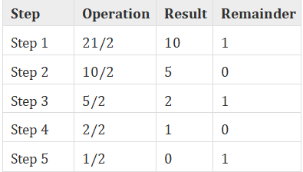
Other Base System to Non-Decimal System
Step 2 –
Convert Decimal to Binary
Decimal Number−21₁₀=Binary Number−10101₂
Octal Number − 25₈= Binary Number – 10101₂

Slide 15
Shortcut method –Binary to Octal
Step1−Divide the binary digits in to groups of three (starting from the right).
Step2−Convert each group of three binary digits to one octal digit.

Slide 16
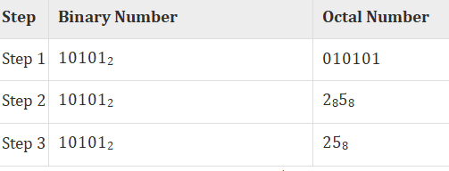
Shortcut method –Binary to Octal
Binary Number − 10101
Calculating Octal Equivalent –
Binary Number−10101₂ = Octal Number – 25₈

Slide 17
Shortcut method –Octal to Binary
Step 1− Convert each octal digit to a 3 digit binary number (the octal digits may be treated as decimal for this conversion).
Step 2− Combine all the resulting binary groups (of 3 digits each) into a single binary number.

Slide 18
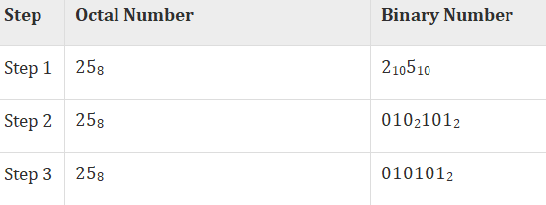
Shortcut method –Octal to Binary
Octal Number−25₈
Calculating Binary Equivalent−
Octal Number − 25₈ = Binary Number − 10101₂

Slide 19
Shortcut method – Binary to Hexadecimal
Step1 − Divide the binary digits into groups of four (starting from the right).
Step2 − Convert each group of four binary digits to one hexadecimal symbol.

Slide 20
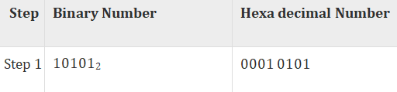
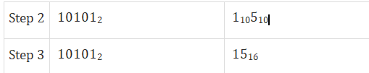
Shortcut method – Binary to Hexadecimal
Example
Binary Number−10101₂
Calculating hexadecimal Equivalent−
Binary Number −10101₂ = Hexadecimal Number−15₁₆

Slide 21
Shortcut method – Hexadecimal to Binary
Step 1− Convert each hexadecimal digit to a 4 digit binary number (the hexadecimal digits may be treated as decimal for this conversion).
Step 2− Combine all the resulting binary groups (of 4 digits each) into a single binary number.

Slide 22
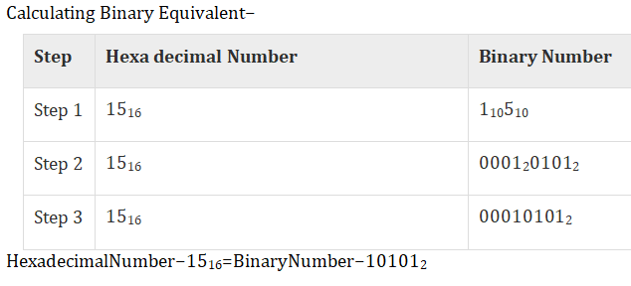
Shortcut method – Hexadecimal to Binary
Example
Hexadecimal Number – 15₁₆

Slide 23
Data Types
The data types found in the registers of digital computers may be classified as being one of the following categories:
1. Numbers used in arithmetic computation,
2. Letters of the alphabet used in data processing,
3. Other discrete symbols used for specific purposes.
Data are numbers and other binary-coded information that are operated on to achieve required computational results.
All types of data, except binary numbers, are represented in binary-coded form.

Slide 24
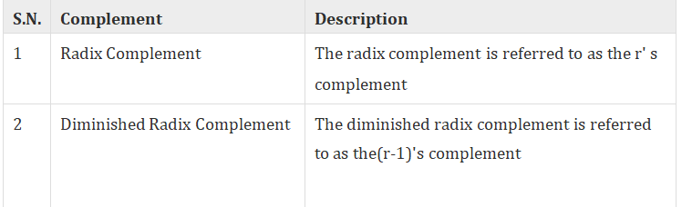
Complements
Complements are used in the digital computers in order to simplify the subtraction operation and for the logical manipulations. For each radix-r system (radix r represents base of number system) there are two types of complements.
As the binary system has base r = 2. So the two types of complements for the binary system are 2's complement and 1's complement.

Slide 25
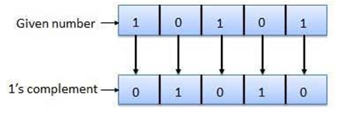
1’s Complement
The 1's complement of a number is found by changing all 1's to 0's and all 0's to 1's.

Slide 26
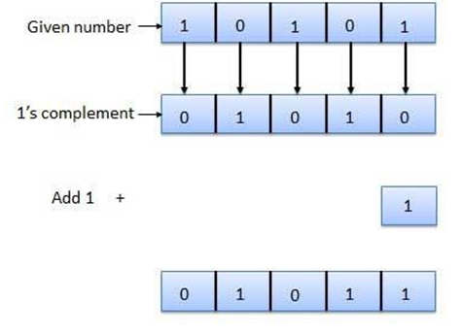
2’s Complement
The 2's complement of binary number is obtained by adding 1 to the Least Significant Bit (LSB) of 1's complement of the number.
2's complement = 1's complement + 1

Slide 27
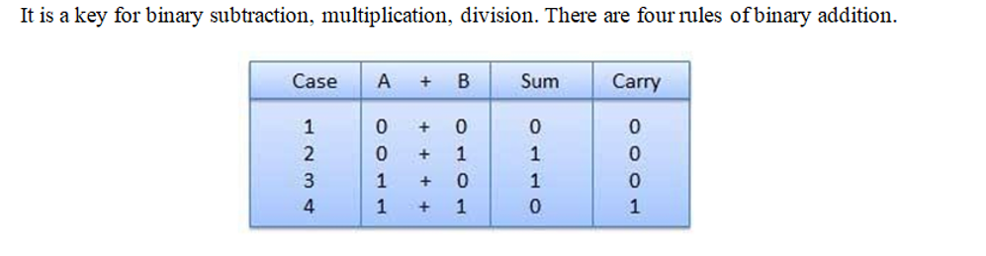
Binary Arithmetic
Binary arithmetic is essential part of all the digital computers and much other digital system
Binary Addition

Slide 28
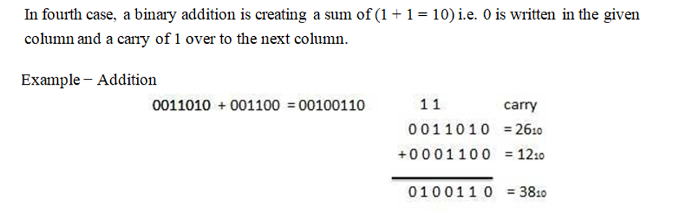
Binary Arithmetic

Slide 29
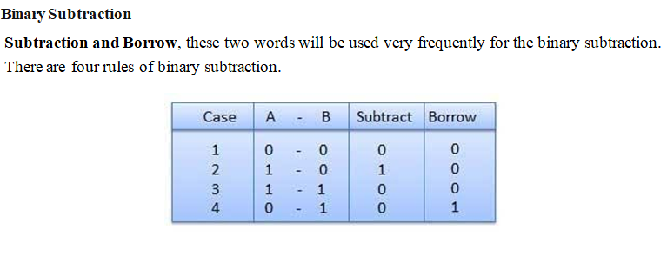
Binary Arithmetic

Slide 30
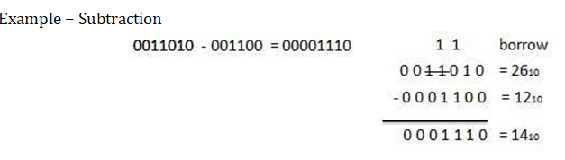
Binary Arithmetic

Slide 31
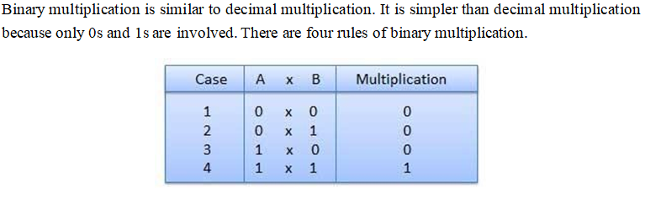
Binary Arithmetic
Binary Multiplication

Slide 32
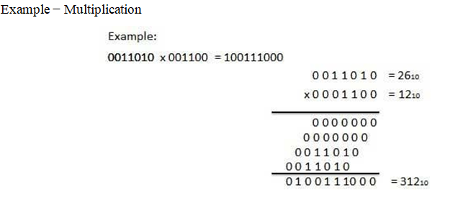
Binary Arithmetic

Slide 33
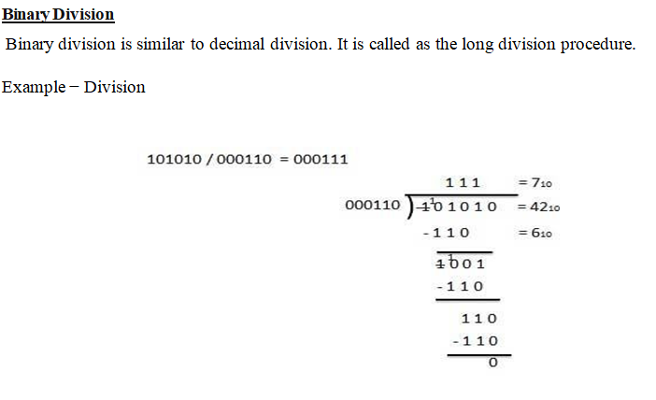
Binary Arithmetic

Slide 34
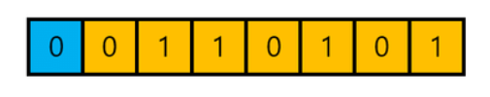
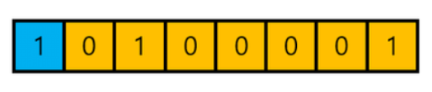
Fixed Point Represention
Positive integers and zero can be represented by unsigned numbers
Negative numbers must be represented by signed numbers since + and – signs are not available, only 1’s and 0’s are
Signed numbers have msb as 0 for positive and 1 for negative – msb is the sign bit
Positive Number
Negative Number

Slide 35
Fixed Point Represention
When an integer is positive ,the MSB or Sign bit is 0 and remaining bits represents the magnitude
When an integer is negative ,the MSB or Sign bit is 1 and remaining bits representing number can be represented in one of the three ways
Signed –Magnitude Representation
Signed – 1’s Complement Representation
Signed -2’s complement Representation

Slide 36
Fixed Point Represention
Example 1 : Consider 8 bit register and +14 is to be
Example 2 : Consider 8 bit register and -14 is to be
Signed Magnitude
1’s Complement
2’s Complement
0
0
0
0
1
1
1
0
1
0
0
0
1
1
1
0
1
1
1
1
0
0
0
1
1
1
1
1
0
0
1
0

Slide 37
Fixed Point Represention
Rules for Addition of two signed-magnitude numbers
If same signs, add the two magnitudes and use the common sign
Differing signs, subtract the smaller from the larger and use the sign of the larger magnitude
Must compare the signs and magnitudes and then either add or subtract

Slide 38

Fixed Point Represention
Rules for Addition of two signed-magnitude numbers
If same signs, add the two magnitudes and use the common sign

Slide 39
Fixed Point Represention
Rules for Addition of two signed-magnitude numbers
Addition of two signed 2’s complement numbers doesnot requires a comparison or subtraction ,only complementation and addition
Add two numbers ,including their sign bits
Discard any carry out of the sign bit position
All negative numbers must be in the 2’s complement form
If the sum obtained is negative ,then it is in 2’s complement form

Slide 40



Fixed Point Represention
Rules for Addition of two signed-magnitude numbers

Slide 41
Fixed Point Represention
Overflow
An Overflow occurs when two numbers of n digits each are added and sum occupies n+1 digits
Overflow are problems since width of registers are finite
Flag is set if overflow occurs and can be checked by users
Detection of overflow depends on if numbers are signed or unsigned

Slide 42
Fixed Point Represention
Overflow
For unsigned numbers, an overflow is detected from the end carry out of the msb
For addition of signed numbers, an overflow cannot occur if one is positive and one is negative both have to have the same sign

Slide 43

Fixed Point Represention
Addition of two signed numbers is as follows

Slide 44
Fixed Point Represention
Subtraction of two signed 2’s complement numbers is as follows
Take the 2’s complement form of the subtrahend (including sign bit)
Add it to the minuend (including the sign bit)
A carry out of the sign bit position is discarded

Slide 45
Fixed Point Represention
+ 70 01000110
-
+ 80 10110000
-------------------------------
11110110

Slide 46
Fixed Point Represention
The representation of decimal numbers in registers is a function of the binary code used to represent a decimal digit
A 4-bit decimal code requires four flip-flops for each decimal digit
This takes much more space than the equivalent binary representation and the circuits required to perform decimal arithmetic are more complex

Slide 47
Fixed Point Represention
Representation of signed decimal numbers in BCD is similar to the representation of signed numbers in binary
Either signed magnitude or signed complement systems
The sign of a number is represented with four bits
0000 for +
1001 for –

Slide 48
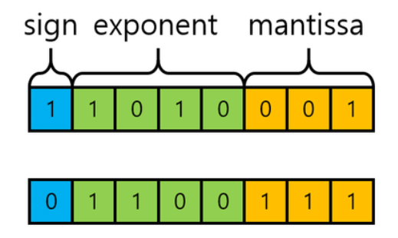
Floating Point Represention
The floating-point representation of a number has two parts
The first part represents a signed, fixed-point number – the mantissa
The second part designates the position of the binary point – the exponent
The mantissa may be a fraction or an integer

Slide 49
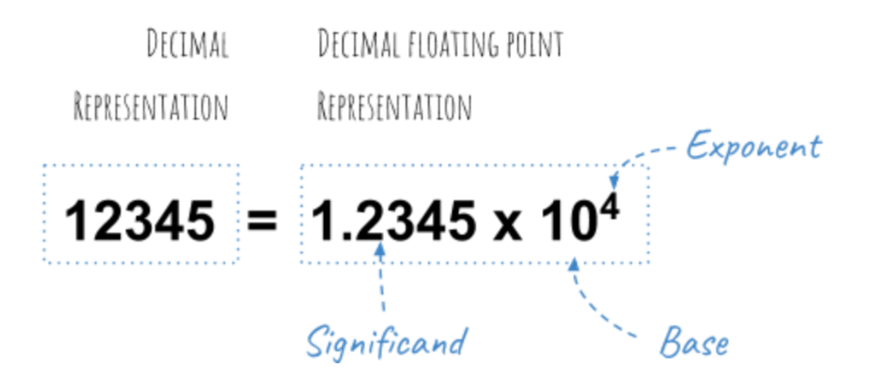
Floating Point Represention

Slide 50
Floating Point Represention
Example: the decimal number +6132.789 is
Fraction: +0.6132789
Exponent: +04
Equivalent to +0.6132789 x 10⁺⁴
A floating-point number is always interpreted to represent m x e

Slide 51
Floating Point Represention
Example: the binary number +1001.110(with 8-bit fraction and 6-bit exponent)
Fraction : 01001110
Exponent = 000100
Equivalent to (.1001110)₂ * 2⁺⁴
A floating-point number is said to be normalized if the most significant digit of the mantissa is nonzero

Slide 52
Alphaneumeric Codes
Binary Coded Decimal Code
Binary Coded Decimal, or BCD, is process for converting decimal numbers into their binary equivalents.
It is a form of binary encoding where each digit in a decimal number is represented in the form of bits.
This encoding can be done in either 4-bit or 8-bit (usually 4-bit is preferred).

Slide 53
Alphaneumeric Codes
Binary Coded Decimal Code
It is a fast and efficient system that converts the decimal numbers into binary numbers as compared to the existing binary system.
These are generally used in digital displays where is the manipulation of data is quite a task.
The BCD equivalent of a decimal number is written by replacing each decimal digit in the integer and fractional parts with its four bit binary equivalent.

Slide 54
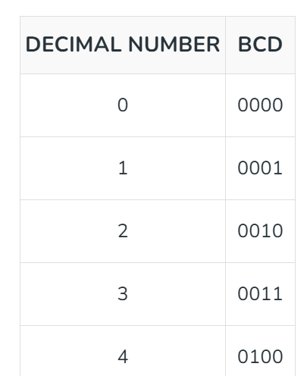
Alphaneumeric Codes
Binary Coded Decimal Code
The BCD code is more precisely known as 8421 BCD code , with 8,4,2 and 1 representing the weights of different bits in the four-bit groups, Starting from MSB and proceeding towards LSB.

Slide 55
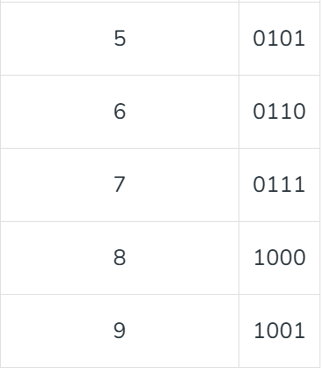
Alphaneumeric Codes
Binary Coded Decimal Code

Slide 56
Alphaneumeric Codes
Extended Binary Coded Decimal Interchange Code (EBCDIC)
In 1964, BCD was extended to an 8-bit code, Extended Binary-Coded Decimal Interchange Code (EBCDIC).
EBCDIC was one of the first widely-used computer codes that supported upper and lowercase alphabetic characters, in addition to special characters, such as punctuation and control characters.
EBCDIC and BCD are still in use by IBM mainframes today.

Slide 57
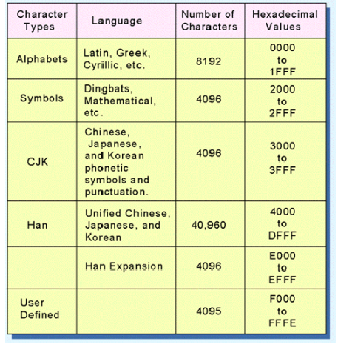
Alphaneumeric Codes
Extended Binary Coded Decimal Interchange Code (EBCDIC)

Slide 58
Alphaneumeric Codes
American Standard Code for Information Interchange (ASCII)
A standard way of encoding characters into numbers so that computers can understand them.
It's used for text data on the internet and in computers.
ASCII uses 7 or 8 bits to represent characters
In standard ASCII encoded data ,there are unique values for 128 alphabetic , numeric and additional characters and control codes

Slide 59
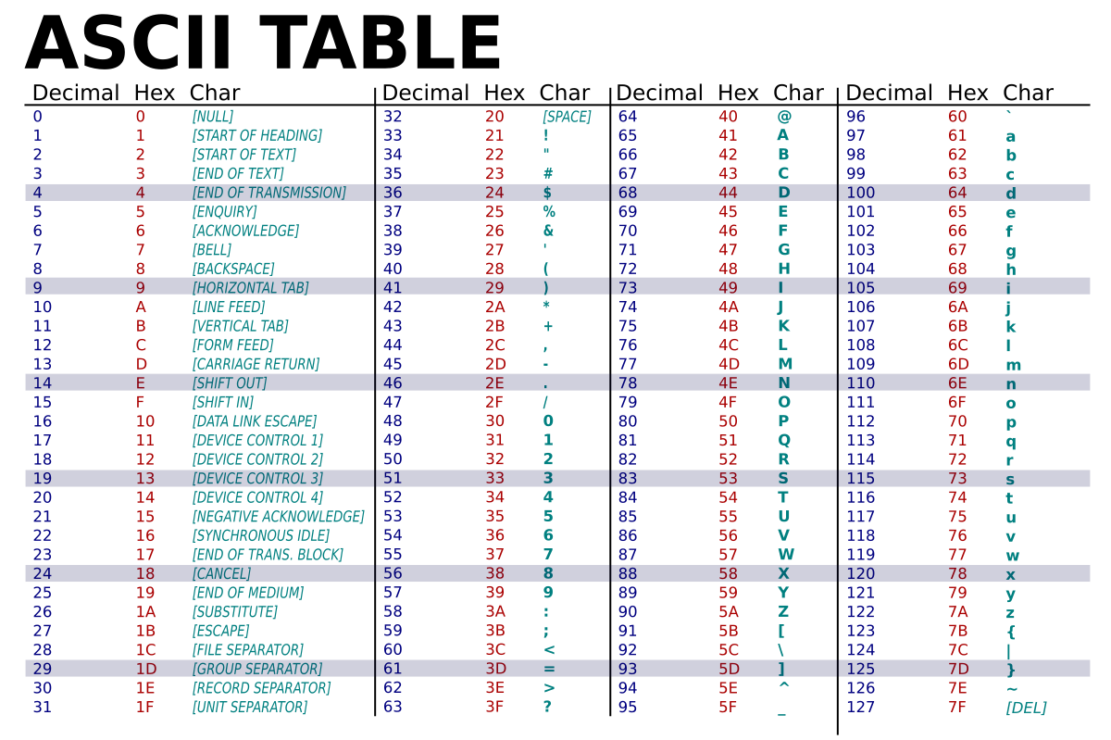

Slide 60
Alphaneumeric Codes
American Standard Code for Information Interchange (ASCII)
ASCII has 128 code points ,of which 95 characters are printable characters
First 33 code points are nonprinting control codes like carriage return and tab
ASCII code is based on order of english alphabet

Slide 61
Alphaneumeric Codes
UNICODE
Both EBCDIC and ASCII were built around the Latin alphabet.
In 1991, a new international information exchange code called Unicode.
Unicode is a 16-bit alphabet that is downward compatible with ASCII and Latin-1 character set.
Because the base coding of Unicode is 16 bits, it has the capacity to encode the majority of characters used in every language of the world.
Unicode is currently the default character set of the Java programming language.

Slide 62
Alphaneumeric Codes
UNICODE
The Unicode code space is divided into six parts. The first part is for Western alphabet codes, including English, Greek, and Russian.
The lowest-numbered Unicode characters comprise the ASCII code.
The highest provide for user-defined codes.

Slide 63
Computer Arithmetic
Arithmetic instructions in digital computers manipulate data to produce results necessary for the solution of computational problems
These instructions perform arithmetic calculations and are responsible for the bulk of activity involved in processing data in a computer.
The four basic arithmetic operations are addition, subtraction, multiplication, and division.

Slide 64
Computer Arithmetic
The arithmetic operation in the digital computer manipulate data to produce results. It is necessary to design arithmetic procedures and circuits to program arithmetic operations using algorithm.
The algorithm is a solution to any problem and it is stated by a finite number of well-defined procedural steps.

Slide 65
Computer Arithmetic
The algorithms can be developed for the following types of data
Fixed Point Binary data in signed magnitude representation
Fixed point binary data in signed 2’s complement representation

Slide 66
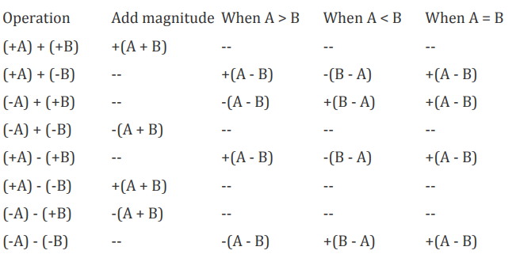
Computer Arithmetic

Slide 67
Computer Arithmetic
Floating point Representation
Binary coded decimal data

Slide 68
Addition/Substraction Algorithm
When the signs of A & B are identical, add the two magnitudes and attach the sign of A to the result.
When the sign of A & B are different, compare the magnitude and subtract the smaller number from the large number.
Choose the sign of the result to be same as A if A > B, or the complement of the sign of A if A < B.
If the two numbers are equal, subtract B from A and make the sign of the result positive

Slide 69
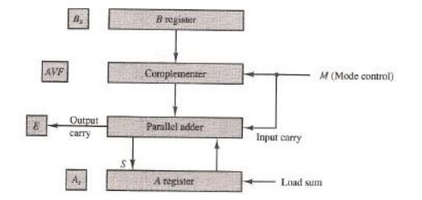
Addition/Substraction Algorithm

Slide 70
Addition/Substraction Algorithm
The hardware consists of two registers A and B to store the magnitudes, and two flipflops As and Bs to store the corresponding signs.
The results can be stored in the register A and As which acts as an accumulator.
The subtraction is performed by adding A to the 2’s complement of B. The output carry is transferred to the flip-flop E.

Slide 71
Addition/Substraction Algorithm
The overflow may occur during the add operation which is stored in flip flop AVF
When m=0 ,the output of E is transferred to the adder without any change along with the input carry of 0
The output of the parallel adder is equal to A + B which is an add operation.
When m = 1, the content of register B is complemented and transferred to parallel adder along with the input carry of 1. Therefore, the output of parallel is equal to A + B’ + 1 = A – B which is a subtract operation.

Slide 72
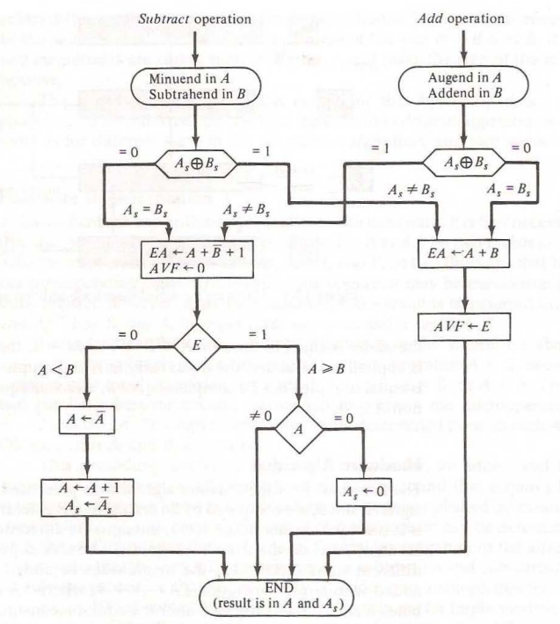
Addition/Substraction Algorithm

